Slide 1

Health and Safety Risk Assessment
Training

Slide 2
Why?
Prevent accidents – Moral – Legal - Financial
HSWA 1974 – Ensure ‘so far as reasonably practicable’, the health, safety and welfare of employees and protect people from risks. Provide suitable and sufficient assessment of risk and control of workplace hazards.
Section 3 – duty to ensure that persons not at work, are not exposed to risks to their health or safety
MHSWR(1999) – ‘Suitable and sufficient’ assessment of risks, record significant findings and apply ‘principles of prevention’.
Secondary legislation

Slide 3
Key Definitions
Hazard: Something with the potential to cause harm or damage.
Risk: this is the likelihood that a hazard will cause harm combined with how severe that harm could be, resulting in potential consequences.
Consequence: this is the outcome of the hazard being realised and the Residual Risk.
Control measure: Anything that is done or put in place to eliminate or reduces the risk of harm or damage. Control measures can be preventative or protective.
Risk assessment: this is the process of identifying hazards, evaluating the associated risks, considering the adequacy of existing control measures and deciding if more should be done to prevent harm or damage.

Slide 4
Suitable and Sufficient
'Suitable' relates to the method used to assess the risk and 'sufficient' relates to the extent or depth of that methodology. To be 'suitable and sufficient', an assessment needs to:
﻿﻿identify risks connected with the work being assessed
﻿﻿provide a level of detail that is proportional to the risk
﻿﻿ignore insignificant risks, likely to result in minor outcomes
﻿﻿consider all those who might be affected
make use of relevant information, such as legislation, guidance, instructions
reflect the nature of the work; and
remain valid for a reasonable period of time.
A risk assessment will not need to anticipate those risks that are not reasonably foreseeable.

Slide 5
Common Errors
﻿﻿carrying out a risk assessment to justify decisions already made.
﻿﻿not involving other people in the assessment or those with practical knowledge of the process/activity being assessed.
﻿﻿failing to identify hazards associated with a particular activity.
failing to fully consider all possible outcomes.
suggesting controls that are not directly addressing a specific hazard.
Failing to properly evaluate the risks or evaluation that doesn’t make sense.
Probably the most common error of all:
not doing anything with the results of the assessment

Slide 6
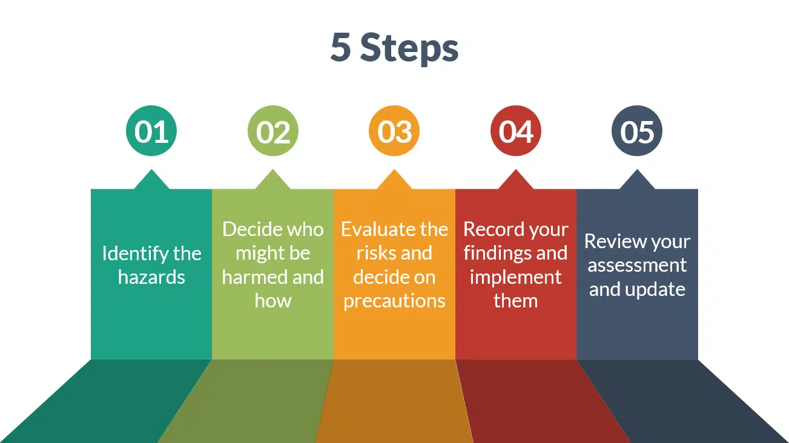
5-Step Approach

Slide 7
Step 1 – Identify The Hazards
Physical
Slips, trips and falls, falling objects, collision with objects, trapping/crushing under or between objects, manual handling, contact with machinery or vehicles, electricity (sometimes causing fire and explosion), Working with hot materials, Noise, Vibration.
Chemical
Acids and solvents.
Biological
Living organisms such as legionella bacteria
Ergonomic
Poorly designed workstations, tasks and equipment
Psychosocial
Work-related stress, Workplace violence, Workplace bullying
Hazardous Substances
Hazardous substances form an unofficial category of their own. They overlap with physical, chemical and biological hazards. Hazardous substances come from dusts like Silica; gases like carbon monoxide; liquid chemicals such as solvents and cleaning materials; and biological organisms such as Legionella which causes Legionnaires' disease.

Slide 8
Identification methods
Using legislation, ACOP’s, and British Standards to guide hazard identification
Task analysis
Workplace inspections
Accident/incident data
Incident investigations
Ill-health records and absence records
Audit reports
Workers/people
Manufacturer's information
MSDS

Slide 9
Hazards in Focus
Consultation with workers should be part of the initial risk assessment procedure, however, consultation should also be part of the ongoing control of risk, so that everyone is aware of changes to existing identified hazards, new hazards which may arise, and what steps can be taken to control them.
The process of regular consultation is another way of building workplace competence.

Slide 10
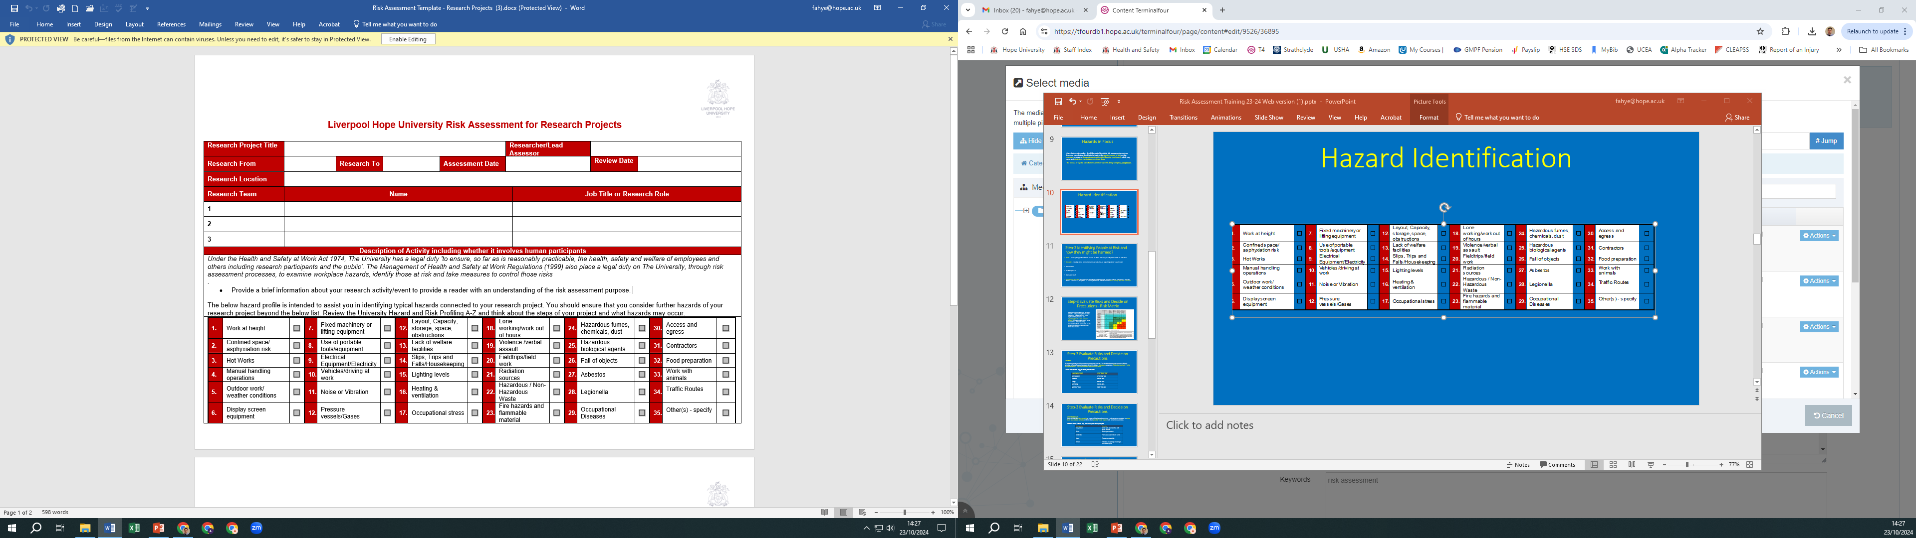
Hazard Identification
The below hazard area descriptions will help you to decide what could cause harm as part of your risk assessment hazard identification process. You can also make use of the University Risk Profile, A-Z Hazard and Risk Profile A-Z for more detailed considerations and example control measures.

Slide 11
Step-2 Identifying People at Risk and how they might be harmed?
Staff - directly engaged in a task as well as those working nearby who could be affected.
Students - younger/not competent/ more vulnerable, requiring closer supervision.
Contractors
Visitors/public
Domestic Staff
Vulnerable people - lack of understanding or knowledge. Young workers, disabilities, existing health conditions, pregnant or nursing mothers, lone workers – How many? Greater scrutiny?

Slide 12
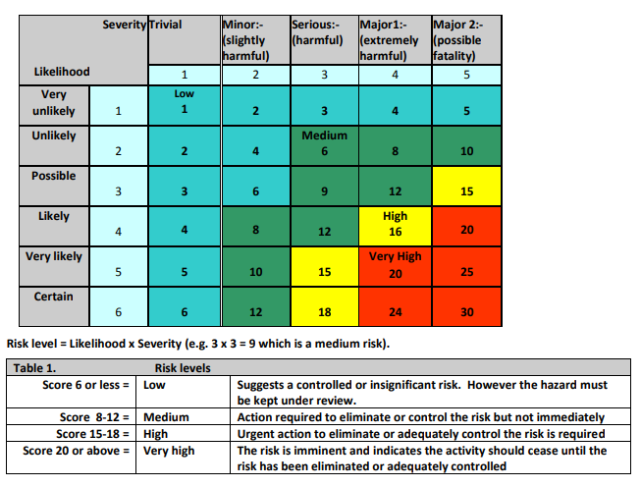
Step-3 Evaluate Risks and Decide on Precautions - Risk Matrix
A matrix style evaluation can be used if preferred as it positively helps to rank risk actions and highlight the most significant risks, however can negatively provide a false sense of security. for the type and nature of risk encountered at the University, evaluation methods on slides 13-16 are considered easier and provide more clarity of evaluation.

Slide 13
Step-3 Evaluate Risks and Decide on Precautions
Likelihood
An important part of your risk assessment process is to evaluate if the identified hazards and risks are sufficiently controlled or if more needs to be done to control the risk to a low/tolerable acceptance. Think about how likely it is that the hazard will occur in the environment in which it is encountered.
Use the below chart to help you identify the likelihood.
Likelihood of harm | Percentage scale
Very unlikely | Less than 10%
Unlikely | 10% to 39%
Likely | 40% to 59%
Very likely | 60% to 80%
Almost certain | More than 80%

Slide 14
Step-3 Evaluate Risks and Decide on Precautions
Severity/impact
Now consider the likely severity or impact of the hazard occurring. It is important to consider the most likely and realistic outcome and not what ‘possibly’ could happen with unrealistic outcomes.
Use the below chart to help you identify the severity/impact
Severity/impact | Description
Very Minor | Minor cuts or scratches with minor first aid
Minor | Bruising or sprains
Moderate | Fractures, deep cuts or burns
Major | Permanent disability
Severe | Fatalities or damage causing a critical disruption

Slide 15
Step-3 Evaluate Risks and Decide on Precautions
Risk rating and prioritisation of risk
When evaluating risk, the likelihood and severity are both considered together to arrive at an overall residual risk. Consider each hazard and think about the safety control measures already in place to help reduce the risk associated with the hazard. Choose the outcomes on the scale that you think represent the reality of the activity. The chosen outcomes are then cross referenced as follows to arrive at the residual risk rating.
Likelihood | The risk level for the hazard under evaluation should be determined by considering the (Likelihood) and then cross referencing with the likely (Severity/impact) to arrive at the Overall Risk Evaluation.
Almost certain | Medium | Medium | High | High | High
Very Likely | Low | Medium | High | High | High
Likely | Low | Medium | Medium | High | High
Unlikely | Low | Low | Low | Medium | Medium
Very unlikely | Low | Low | Low | Low | Medium
Severity/impact | Very Minor | Minor | Moderate | Major | Severe

Slide 16
Step-3 Evaluate Risks and Decide on Precautions
Low | Acceptable or Tolerable - No additional controls required. The risk is at a level that can be accepted provided controls are implemented.
Medium | Moderate Risk – Action and control is needed to reduce the risk. Think again about your control measures and decide what else can be done to reduce the risk.
High | Substantial Risk – The residual risk is too high. Work is not to be started or continued.

Slide 17
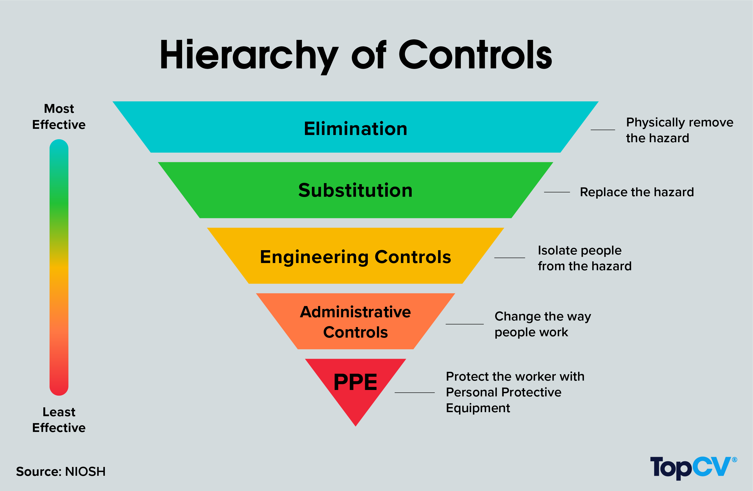

Slide 18
Elimination – can I remove the hazard altogether? If not, how can I control the risks so that harm is unlikely?
Substitute the hazard – try a less risky option (e.g., switch to using a less hazardous substance).
Contain the risk/ Engineering Controls – prevent access to the hazard (e.g., by guarding).
Administrative Controls - Change the way work is carried out/training/SOP, Task analysis/Method
Reduce exposure to the hazard – reduce the number of people exposed to the hazard and/or reduce the duration of exposure.
Personal protective equipment – provide PPE for individual risks.
Skill/supervision – rely on the competence of the individual.
Welfare arrangements – provide washing facilities to remove contamination and first-aid facilities.

Slide 19
Focus
Legal requirements should be the starting point when considering control measures.
Guidance is available from a range of national and international sources that provides details of controls for specific hazards and can save time and effort in deciding what is and what is not needed to control the risk.
The means by which risks associated with specific hazards are reduced will vary according to the hazard.
Reducing risks associated with chemicals may involve a change to a less hazardous substance. If the issue is reducing risk associated with manual handling, the use of smaller loads or mechanical aids should be considered.
For all hazards, the control measures need to follow the general hierarchy of control.
Distinction between priorities and timescales
Ideally, a high-priority action would be completed very quickly. Depending on the complexity of what has been recommended, it may take quite a while to action recommendations, even if they are high priority.
For example, training staff may be a high priority, but the timescale for delivery might be several months because the training needs to be developed and rolled out to all staff.
An assessment might identify a low-risk issue, which because it is a low risk will be a low priority for action. However, if the actions can be done quickly and cheaply, the timescale for implementing the recommendation would be measured in days rather than months, even though the action itself is not a high priority.

Slide 20
Step-4 Record Significant Findings
It is essential to record significant findings so that an accurate picture of the risks can be built up and so that appropriate controlling action can be taken.
Insignificant, or 'trivial' findings need not be recorded.
There is no standard way in which risk assessment findings must be recorded.
There are, however, common contents that all risk assessments should share. These include:
﻿﻿recognition of hazards;
﻿﻿identification of persons at risk;
﻿﻿consideration of existing control measures;
﻿﻿consideration of further controls; and
A sensible review date that is acted on.

Slide 21
Step-5 Review and Update
Risk assessment is not a one-off process and it is essential to keep the risk assessment under review.
Review date - This will normally be in line with the highest level of residual risk calculated in the assessment. For example: if the highest risk identified on a risk assessment is a moderate risk to be actioned within three months, it follows that the review date would be set for three months' time.
Following an incident
Changes in processes or equipment
Changes in staff
Changes in the law
Regular scheduled review
At least annual
Good idea to maintain a spreadsheet of your risk assessments with review dates.

Slide 22
